Slide 1
Adding TECHNOLOGY TO A CENTURY OLD PLANT
The Clemson Brick Forum
October 2012
Notes:
Appreciate the opportunity to talk to you this morning
I am one of least technical people in room
Colleagues at WG can best answer your questions
Installed, operate and trouble-shoot the equipment daily
WG is small place and somewhat of an anomaly in the industry
Only three manufacturers of dry-pressed brick or pavers in North America
West Texas
Missouri
WG

Slide 2
History
Approach
Recent Addition
Challenges
Looking to the Future
Notes:
Small place 30,000 million brick capacity
Track production and sales in tons as do many in refractory industry
More than half of production is firebrick/split firebrick
Location has operated as a brick plant since early 1900
Alliance Brick facility
Located next to old Alliance Clay facility.
50s/60s Alliance Brick upgraded to tunnel kilns
First Miller Kiln
Then Swindel Kiln
Alliance Clay continued with periodic kilns
Now out of business for many years
Purchased by Whitacre family in the 1972
Converted immediately to dry-pressed to make refractory material

Slide 3
Change in Senior Leadership in 2005
Given the opportunity, what changes would we make to build the Whitacre Greer of the future?
Markets and market strategy
Plant and equipment
Notes:
Change in senior leadership due to retirements prompted the question, ‘What is changes are necessary to ensure Whitacre Greer’s success for the next 100 years?’

Slide 4
Inclusive Team Approach
Employees with all levels of responsibility were included
Notes:
Teams created to explore the question
What markets?
What products?
What manufacturing process?
Etc.
With this type of product(s) in mind we turned attention to product methods/systems & equipment.

Slide 5
Boutique-type Manufacture
Short runs of odd items
Markets characterized by low volumes
Notes:
Marketing group identified short runs and production flexibility as opportunities
Odd items
Low volumes
Quick change over important to success

Slide 6
Plant & Equipment Tailored to this Type of Production
Established a ‘wish list’ of potential improvements in order of importance
Notes:
Plant/production group focused efforts on equipment and processes suited to these products/markets
Rapid color changes and ability to produce multiple colors at once was at the top of our wish list
#1 priority of improvements was ability to produce consistent paver colors from run to run
Close second – produce two paver colors simultaneously
Both of these items addressed with the same improvement

Slide 7
Additive Feeders & Blending
Volumetric measurements and manual additive feeders resulted in poor color control
Notes:
Many opportunities for error in the old system. Relied on shift supervisors to weigh material samples traveling along conveyors and adjust accordingly.

Slide 8
Additive Feeders & Blending - 2007
Additive feeders and blending of material PLC controlled
Manual volumetric measurements replaced with automated load cells
Color change controlled with the push of a button
Notes:
Blending system installed 2007
Allows production of different colors on two separate presses
Compact and efficient system sometimes using equipment geared toward other industries
System has proven itself with terrific reliability
As system was being installed we turned to our next challenge – grinding
Test of potential new screening equipment with polyurethane screen mats
Incredibly successful – test sold us on the equipment
Unsuccessfully attempted to plug up the screen during testing varying material size and moisture content
Very pleased with results
We knew what we wanted
Just a matter of time until we were prepared financially to make the improvement

Slide 9
New Grinding Facility
Raw material preparation unreliable
Notes:
By 2011 raw material processing, screening & grinding had become terribly unreliable
New facility was necessary

Slide 10
Existing Grinding Facility was Constant Bottleneck
50-year old dry pan rated new at 10 tons/hour
Escalating maintenance costs
Cramped facility
20 hour/day operation
Notes:
Initial thought was a series of box feeders replacing existing storage
This proved to be cost prohibitive

Slide 11
New Facility Requirements
Sized for future capacity expansion
50-60 tons/hour

Slide 12
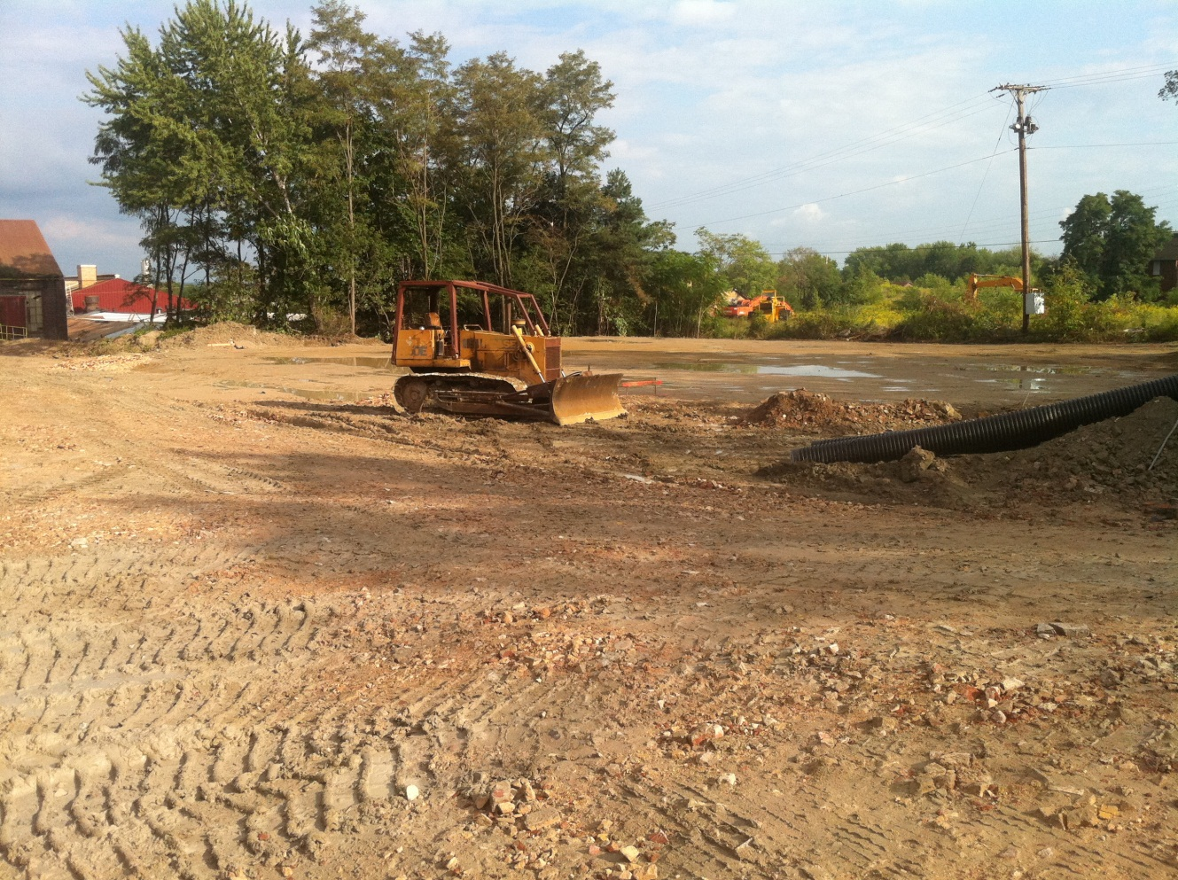
Construction Begins September 2011
Notes:
Construction begins September 2011

Slide 13
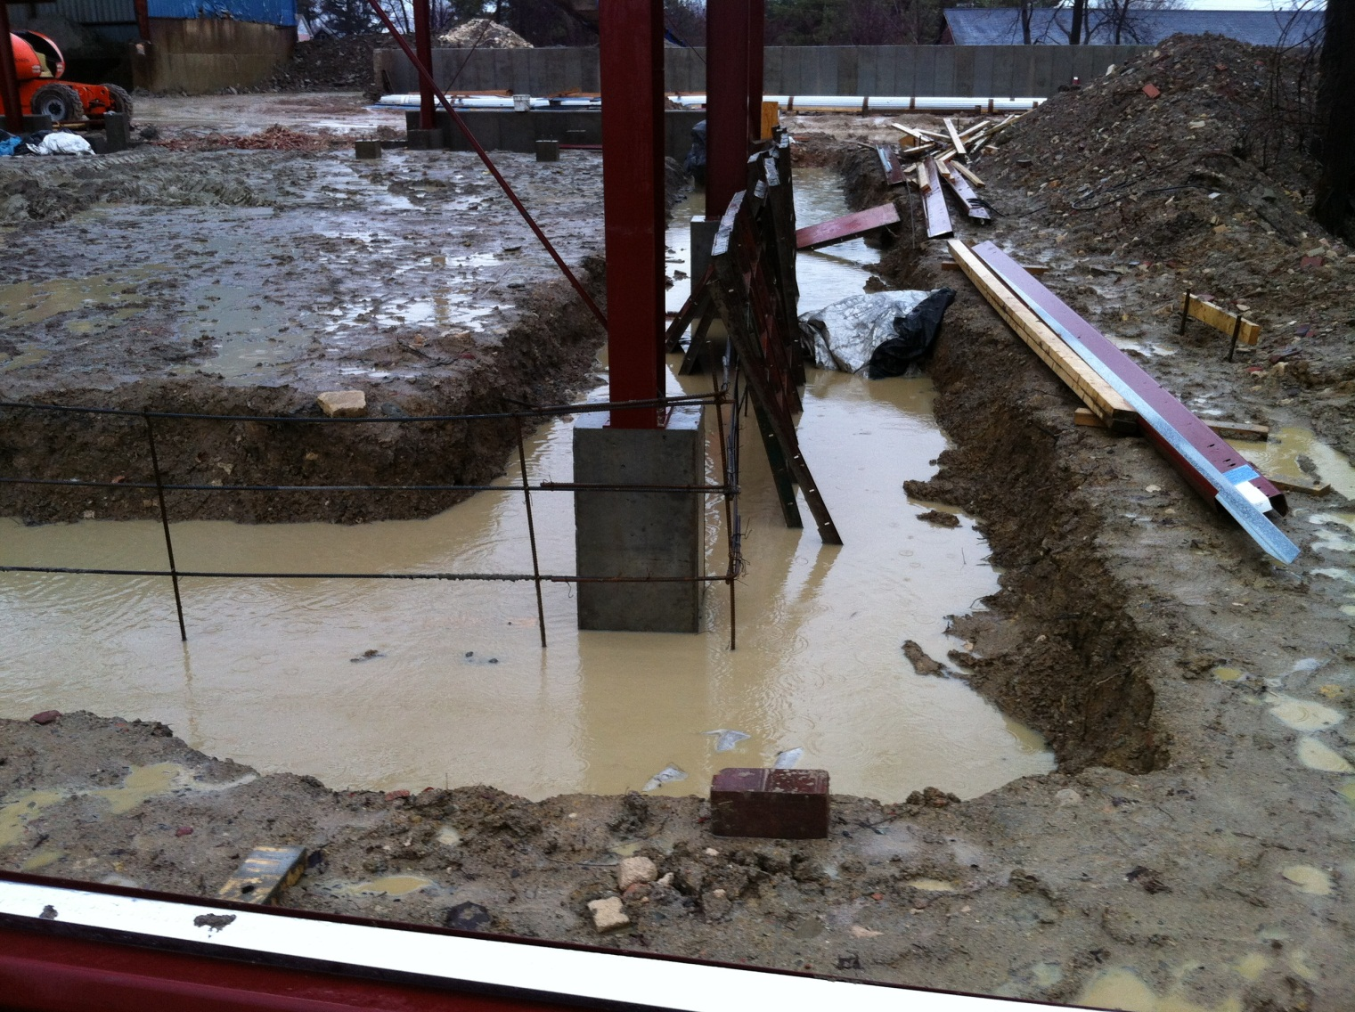

Slide 14
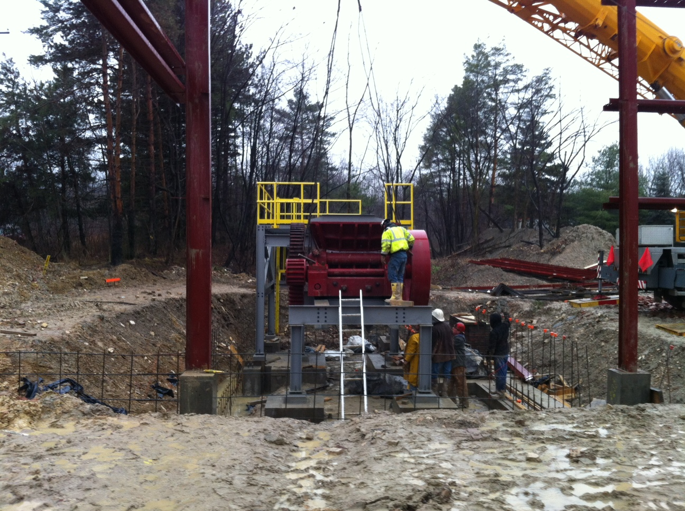

Slide 15
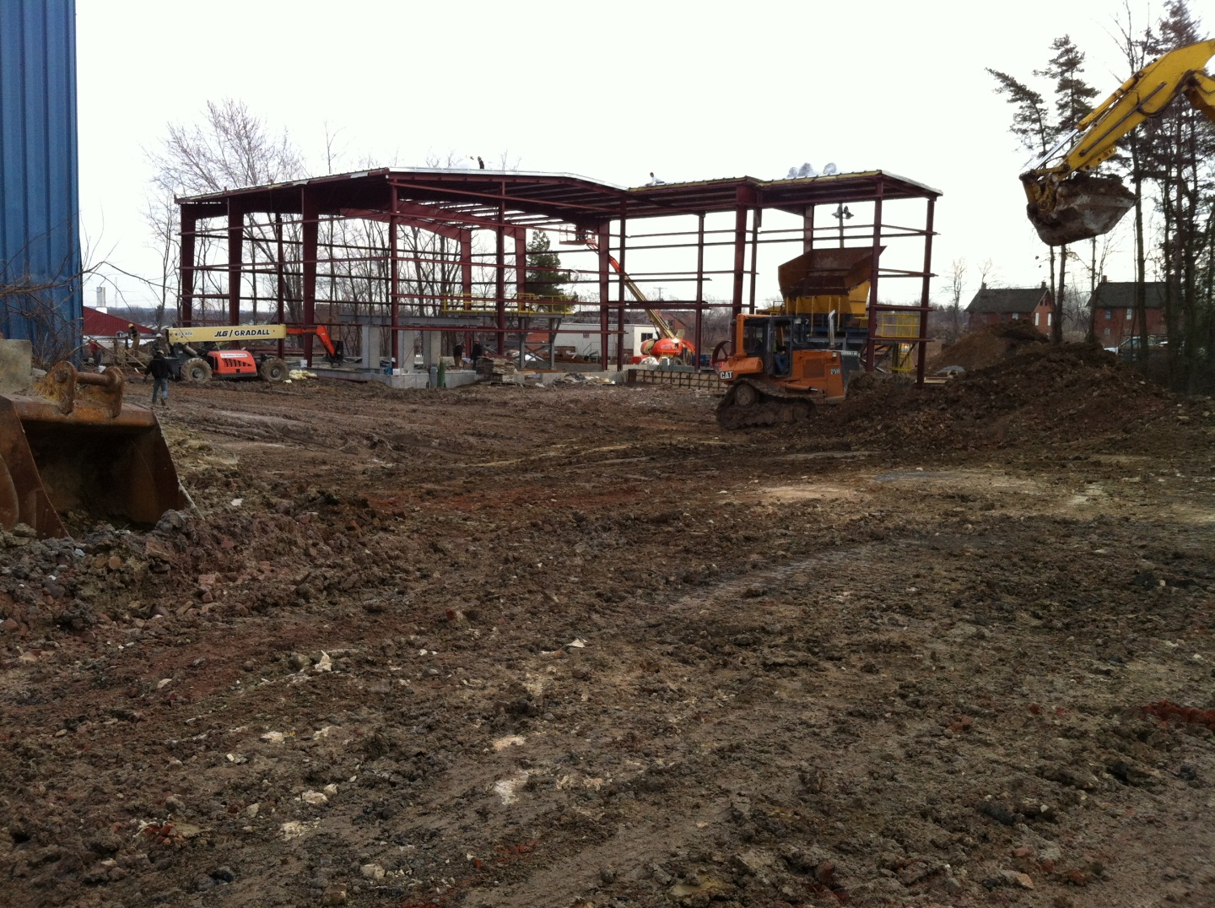
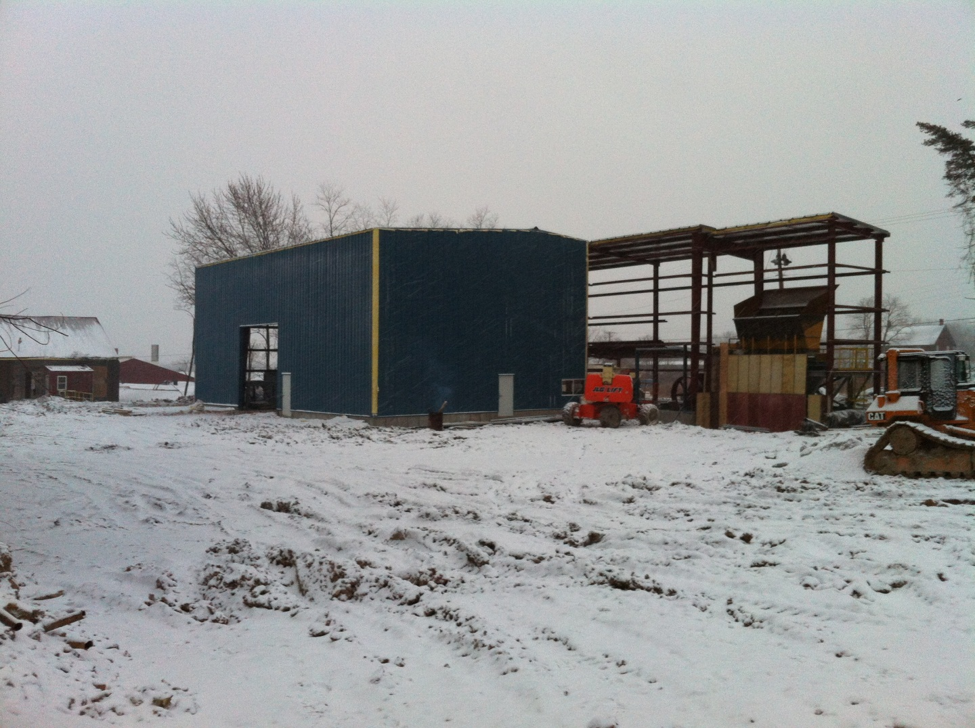

Slide 16
Completed March 8, 2012
McLanahan roll crusher
Bivi-TEC screen
Hazemag Impactor
Marion Mixer
Donaldson Torit dust collector
Notes:
Construction began in September 2011 with a very ambitious completion date of March 1, 2012
Warm winter was bitter sweet – mud was incredible
Project was completed on schedule with the terrific work of outside contractors and WG’s own
4-5 hour/day operation

Slide 17
Roll Crusher

Slide 18
VHV Belt
Permitted compact building footprint

Slide 19
Mixer
Add moisture as needed
Can mix additional additives if needed in future

Slide 20
Impactor
Notes:
Initial concern regarding the difference between material processes through a dry pan vs impactor
Tests indicated that either can be used successfully
Greater green density with impacted material

Slide 21
Impactor Blow Bars
Ceramic impregnation improves wear
Very good results after 6 months of use
Notes:
25% increase in cost / 100% increase in life expectancy
After 6 months of use it appears that we won’t have to flip blow bars before anniversary of 1-year in use

Slide 22
Impactor Heat Controls
Independent zone controls for inlet and curtains
Notes:
Independent zone controls may be an important factor during winter operations
Moisture of raw material is affected by weather

Slide 23
Screen
Polyurethane screen mats do not require heat
Improved throughput with action of mats

Slide 24
Dust Collection
Recycle air through HEPA filter
Recycle collected materials

Slide 25
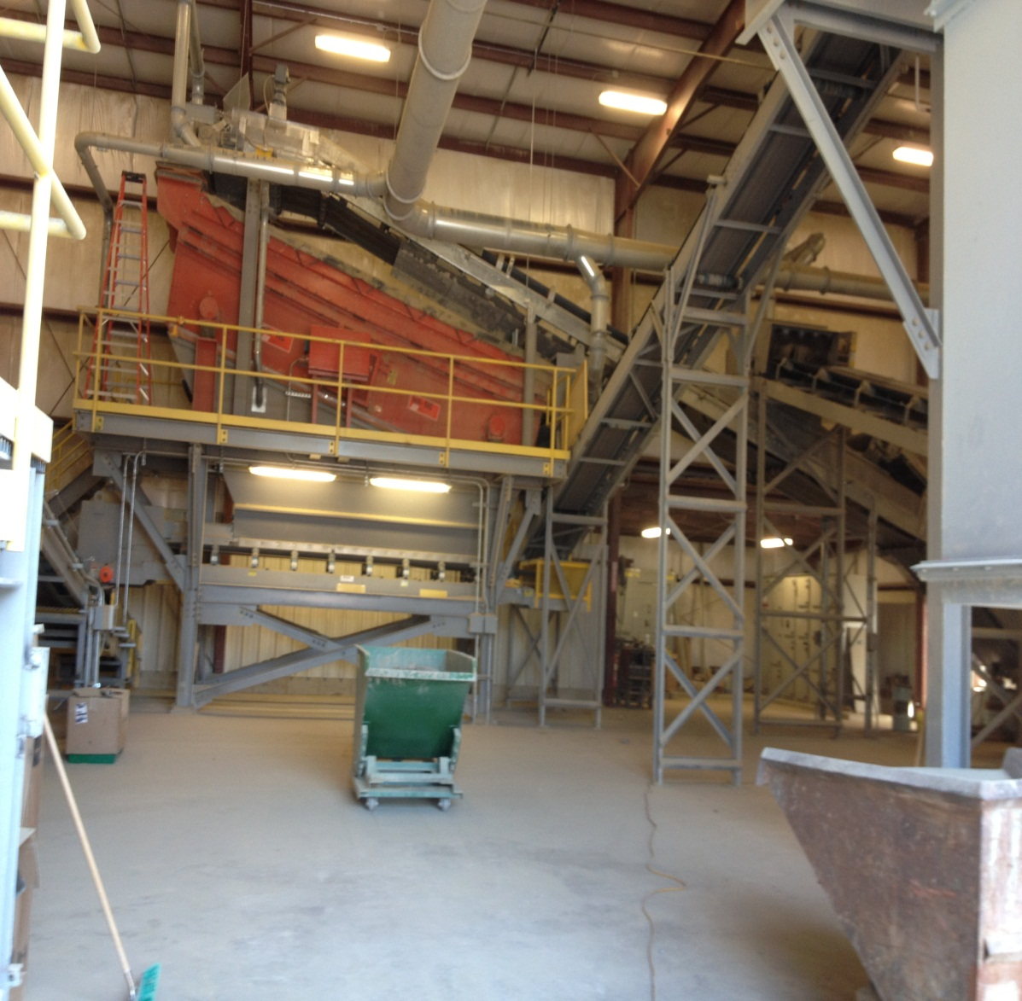

Slide 26
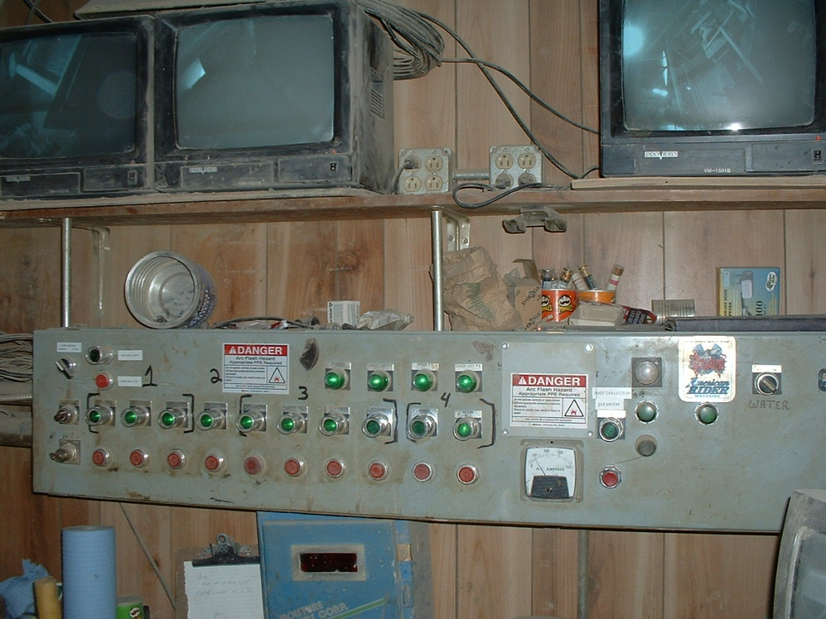
Controls – Old and New
Notes:
Controls new and old for original and new grinding facility.

Slide 27
Stormwater Management
All runoff captured and returned to ground onsite

Slide 28
Stormwater Management
Daily sweeping minimizes clay dust transported by runoff
Bioswale filters runoff and returns it to the ground

Slide 29
Operational Challenges of New Facility
Dust collection
Screen utilization
Particle size distribution of impacted material
Adding moisture
Notes:
Gain control of system overall
Timing and setup adjustments
Dust collection
Cartridge-type vs bag-type
Best available technology – growing pains on design
First unit of this type in clay industry
Engineering changes by manufacturer do to our experience
Vendor and manufacturer have been responsive
Screen utilization
Spreader at screen feed doesn’t work as expected
Piece wasn’t designed for large pieces that we’re sending over it
It has been removed
Scalping and finishing with the same screen
Torn screens due to large size of material being run across
Overloaded and cut screen mats
Trial and error to discover correct selection of screen mats
Many options available
Has allowed fine tuning of finished material
Some mats have been replaced by heavier scalping mats available from the manufacturer
Size of impacted material
Shape of impacted material is different than shape of material from dry-pan
Trial and error to discover correct setup for our process has take time
Corrected now
Addition of moisture
Vendor and manufacturer supportive, but we have not yet been successful here
Work in progress

Slide 30
Next Steps
Purchase of adjacent property for production and warehouse expansion
Early implementation of statistical analytic software to improve response to gathered QC data
Further improvements in quick change production equipment

